Slide 1
BUFFALO PUBLIC SCHOOLS
COVID-19 Protocols and Guidance
from Human Resources

Slide 2
PRIMARY RESOURCES
Erie County Department of Health ( ECDOH)
https://www2.erie.gov/health/coronavirus
The Center for Disease Control (CDC)
www.cdc.gov/coronavirus/2019-ncov
https://emergency.cdc.gov/coping/selfcare.asp
New York State
https://www.governor.ny.gov/news/no-205-quarantine-restrictions-travelers-arriving-new-york
https://paidfamilyleave.ny.gov/if-you-are-quarantined-yourself
Buffalo Public Schools
https://www.buffaloschools.org/Page/89196
Consultation with:
Erie County Personnel Department

Slide 3
TABLE OF CONTENTS
EMPLOYEE SELF-SCREENING FOR WELLESS AND COVID-19 ……………………4
CLOSE CONTACTS OF POSITIVE COVID-19 CASES.....................................................6
QUARANTINE LEAVE ………………………………………………………………………………….8
QUARANTINE PROCESS ……………………………………………………………………………..9
COVID 19-TESTING ……………………………………………………………………………………12
RETURNING TO WORK ………………………………………………………………………………. 16
COVID-19 EMPLOYEE RESOURCES ……………….23

Slide 4
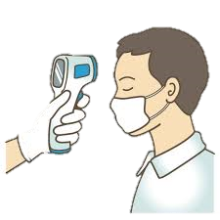
EMPLOYEE SELF-SCREENING FOR WELLNESS AND COVID-19
BPS emp0loyees must self-screen before reporting to and while present at any BPS worksite location. If an employee is ill, even if they are not experiencing COVID-19 symptoms, they should remain home to prevent the spread of any illness.
If an employee is experiencing any of the following symptoms while present at a BPS worksite, they should immediately contact their Supervisor.
Fever or chills
Cough
Shortness of breath or difficulty breathing
Fatigue
Muscle or body aches
Headache
New loss of taste or smell
Sore throat
Congestion or runny nose
Nausea or vomiting
Diarrhea

Slide 5
What if I come in contact with someone who may have COVID-19?

Slide 6
CLOSE CONTACTS OF POSITIVE COVID-19 CASES
A close contact of a positive COVID-19 is defined as any individual who was within six (6) feet of an infected person for at least ten (10) minutes starting from 48 hours before the onset of COVID-19 symptoms.
Close contacts will be determined by the Erie County Department of Health (ECDOH) and notified through contact tracing. If an employee is a close contact of a positive COVID-19 case, the employee should inform their Supervisor who will notify Human Resources.
A secondary contact, is defined as contact with someone who was in contact with a COVID-19 case, or contact with someone who is being tested for COVID-19. A secondary contact does not require the employee to quarantine.

Slide 7
What happens if I need to quarantine?

Slide 8
QUARANTINE LEAVE
Employees are eligible for up to two weeks of paid leave (“Quarantine Leave”) if they are unable to work onsite or from home due to COVID-19 quarantine, isolation, or symptoms while waiting diagnosis.
Employees placed in at-home quarantine are required to stay home; separate themselves from others, including household members; and monitor their health in accordance with Erie County Department of Health (ECDOH) Guidelines. They are prohibited from visiting with non-household members, and must be tested for COVID-19. COVID-19 test results must be provided to Human Resources.
To apply for Quarantine Leave, employees must submit documentation to Human Resources Department, email, HR_leaves@buffaloschools.org. Negative results of the COVID-19 test must be provided to HR_Leaves@buffaloschools before an employee is cleared to return to work.
After the two week period, employees are required to use their own accrued time to cover any continuing absence.
2
weeks

Slide 9
QUARANTINE PROCESS
An employee must quarantine for one of the following reasons:
Employee is COVID-19 positive and subject to an Isolation Order
Employee is experiencing COVID-19 symptoms and awaiting COVID-19 test results
Employee is non-essential or able to work from home and a confirmed close contact of a positive COVID-19 case
Employee is non-essential or able to work from home and subject to Federal, State, or local Quarantine Order, including fourteen (14) day mandatory quarantine following travel to a designate state.
AN EMPLOYEE REQUIRED TO QUARANTINE FOR ANY REASON MUST BE TESTED FOR COVID-19, AND THEIR TEST RESULTS MUST BE PROVIDED TO THE DEPARTMENT OF HUMAN RESOURCES

Slide 10
QUARANTINE PROCESS
Employee must immediately contact Human Resources with a copy of medical documentation regarding their COVID-19 diagnosis, symptoms, or their Federal, State, or local isolation or Quarantine Order. Medical documentation must be dated and include specific reference to COVID-19, reason for leave (close contact, diagnosis, symptoms, etc.) and the dates of leave. Human Resources will inform your supervisor of approved Quarantine Leave.
Human Resources will inform the employee and supervisor whether the employee qualifies for paid Quarantine Leave and work from home authorization or if the employee is required to use their own time for the duration of the quarantine.
If eligible for paid Quarantine Leave, HR will consult with the employee’s Department and/or Supervisor to determine employee’s ability to work from home. If the employee is able to work from home, they must do so.
Employees should communicate with their Supervisor and Human resources as soon as possible to ensure accurate and complete entering of time. Only payroll can enter Quarantine leave; it cannot be entered by employees

Slide 11
What happens if I have to get tested for COVID-19?

Slide 12
COVID-19 TESTING
Staff are directed to remain home if are experiencing symptoms and to consult with their doctor or service provider via Telemedicine.. Symptoms may appear 2-14 days after exposure to the virus. People with these symptoms may have COVID-19:
Fever/Chills
Cough
Shortness of breath or difficulty breathing
Fatigue
Muscle or body aches
Headache
New loss of taste or smell
Sore Throat
Congestion or runny nose
Nausea or vomiting
Diarrhea
If anyone has a chance to speak with an employee who has expressed concerns about symptoms, please do not direct/mandate them to get the COVID-19 test. Our health insurance will not cover it. They must get a script from a medical provider to get the test. Please encourage them to contact their primary or use telemedicine to speak with a medical professional about their symptoms so that the doctor can instruct their patient on next steps.

Slide 13
POSITIVE COVID-19 TEST
Should a staff member test positive for COVID-19, you must immediately report the finding to Jamie Warren, Associate Superintendent for Human Resources at jwarren@buffaloschools.org. This staff member will be required to quarantine for fourteen (14) calendar days.
Upon confirmation of a positive test result, the Department of Human Resources will employ a procedure that guides our interaction with the employee’s Supervisor and co-workers that:
Ensures and protects confidentiality
Demonstrates ethical and professional conduct
Creates a judgment-free zone
Addresses health and safety concerns through contact tracing
Works collaboratively with the Erie County Department of Health (ECDH) and the Center for Disease Control (CDC)
Works collaboratively with Plant Operations and Custodial Services

Slide 14
NEGATIVE COVID-19 TEST
Should a staff member test negative for COVID-19, please notify your immediate supervisor and Human Resources at HRLeaves@buffloschools.org. You will be required to supply a copy of the results directly to Human Resources only. Once received, notification for clearance to return back to work will be provided to the staff member and their supervisor.
All staff members are reminded to also maintain a high level of confidentiality, ethical, and professional conduct should a member of your team become ill.

Slide 15
When can I come back to work?

Slide 16
RETURNING TO WORK
Paid Quarantine Leave benefits and/or work from home authorization cease as soon as a quarantined employee meets the applicable criteria to return to work.
COVID-19 Positive employees:
After ten (10) or more days have elapsed since the onset of COVID-19 symptoms or ten (10) or more days have elapsed since a positive test is taken, if asymptomatic
COVID-19 symptoms are improving, if symptomatic
Employee has been fever free for at least three (3) days without the use of fever reducing medication
Employee must complete and return to Buffalo Schools “Return to Work Authorization” on or before returning to work. Any delay in returning this form may result in the employee needing to use their own accrued time from date above criteria is met until form is returned.

Slide 17
RETURNING TO WORK
COVID-19 Negative employees:
Employees who were symptomatic but are not a confirmed close contact of a positive COVID-19 case may return to work the day after receiving their negative COVID-19 test results.
Results must be provided to Jamie Warren of the Department of Human Resources ( jwarren@buffaloschools.org)

Slide 18
RETURNING TO WORK
Employees returning from a state that has been designated mandatory fourteen (14) day quarantine:
May return to work ten (10) days after they return to New York State, so long as they test negative for COVID-19.
Proof of travel dates and return to New York State may be requested
Employee must get tested 5-7 days after they return to New York State.
Employees should remain out of work for the full ten (10) day quarantine period, even if their test results are negative.
If an employee tests positive for COVID-19 employee should follow the guidelines under this section for “COVID-19 positive employees”.
Employees that have voluntarily traveled to a state requiring mandatory ten (10) day quarantine, as defined by the Governor in NYS Executive Order No. 205, are not eligible for paid Quarantine Leave, or to work remotely.

Slide 19
COVID-19 EMPLOYEE RESOURCES
Buffalo Public Schools has compiled a list of resources and tips to focus on employee health and wellness during the pandemic:
Managing Stress and Anxiety
Telemedicine
Counseling support and resources through the Employee Assistance Program (EAP)
Ergonomics in setting up your home office and advice on working from home

Slide 20
MANAGING ANXIETY AND STRESS
Take care of your body – Try to eat healthy well-balanced meals, exercise regularly, and get plenty of sleep
Connect with others – Share your concerns with how you are feeling with a friend or family member. Maintain health relationships and build a strong support system
Take breaks – Make time to unwind and remind yourself that strong feelings will fade. Try taking deep breaths, do activities you usually enjoy, and/or meditate.
Stay informed - Watch, listen to, or read the news for updates from officials. Always check your sources and turn to reliable sources of information like your local government authorities.
Seek help when needed – If distress impacts activities of your daily life for several days or weeks, talk to a clergy member, counselor, doctor, or contact the District’s Employee Assistance Provider, ComPsych, for free and confidential support

Slide 21
TELEMEDICINE
$0 cost-share/ waived deductible for Doctor on Demand telemedicine visits
$o cost-share/waived deductible for COVID-19 diagnostic tests
$0 cost-share/waived deductible for all participating physician office, urgent care, and emergency room visits for diagnostic testing related to COVID-19 (not the ongoing treatment)

Slide 23
EMPLOYEE ASSISTANCE PROGRAM
Guidance Resources
The Buffalo Public Schools offers all employees and their families access to an Employee Assistance Program (EAP) through ComPSych Guidance Resources. There is no cost to employees or their families and all information is confidential – no personally identifiable information is sent to the District.
This support is designed to help employees and their families in resolving issues such as :
Marital
Financial and/or Legal
Emotional Problems
Family Issues
Substance/Alcohol abuse
Work & Education

Slide 24
EMPLOYEE ASSISTANCE PROGRAM
On the web: www.guidanceresources.com you can find articles, trainings, and get in touch with Guidance Consultant to speak about the issues that you are personally facing.
WebID: BuffaloSchoolsEAP
BY PHONE: 866-645-1757
TTY: 800-697-0353

Slide 25
CRISIS SERVICES & TEXT HELPLINE
Crisis Services for Buffalo and Erie County provide services for those who are in state of emotional crises:
Buffalo & Erie County Crisis Service – 716-834-3131
24 Hour Addiction Helpline – 716-831-7007
Kids Helpline – 716-834-1144 or 1-877-kids-400
Chautauqua County Helpline – 1-800-724-0461
24 Hour Erie County Domestic Violence Hotline – 716-862-HELP
For Shelter 716-884-6000
24 Hour NYS Domestic & Sexual Violence Hotline – 1-800-942-6906
Hearing Impaired? – use 711 (National Relay Service)
Text line www.crisistextline.org
IF YOU ARE IN A STATE OF EMOTIONAL CRISIS AND NEED IMMEDIATE ASSISTANCE
YOU ARE URGED TO CONTACT CRISIS SERVICES

Slide 26
ERGONOMICS
As many of the BPS staff are now working from home, you may want to consider the following information when setting up your home workspace:
Find a comfortable, stable and supportive chair that allows you to fit comfortably under a desk or table
Establish a neutral working condition so that: your feet are supported by a foot rest of the floor ; your hands, wrists, and forearms are straight and roughly parallel to the floor; your head is level, forward facing, balanced, and generally in-line with the torso; and your shoulders are relaxed and your elbows are bent at an angle between 90 and 120 degrees

Slide 27
WORKING FROM HOME
Other than ergonomics, some other tips on working from home include:
Start your day right by getting up at the same time each day, get dressed, and establish a morning routine
Make a to-do list and create a schedule to keep yourself organized and on task
Limit your distractions and create a positive workspace by putting away your phone, limiting your social media, and if possible rearrange your workspace to make it more aesthetically pleasing
Take purposeful breaks by scheduling time to move away from your work area and engage in something like a walk, grabbing a healthy snack, or mindlessly scrolling through social media
Stay connected with family and friends via virtual meet-ups or safe social distancing

Slide 28
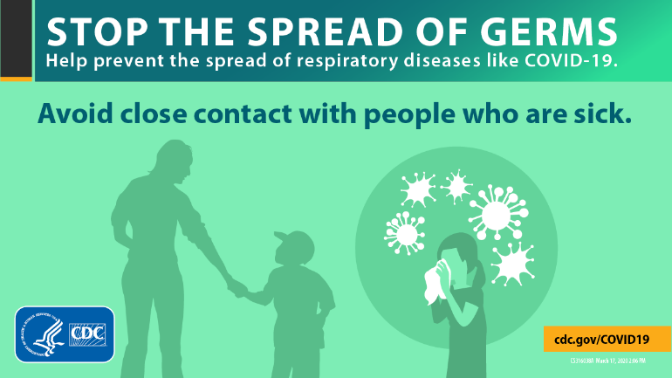
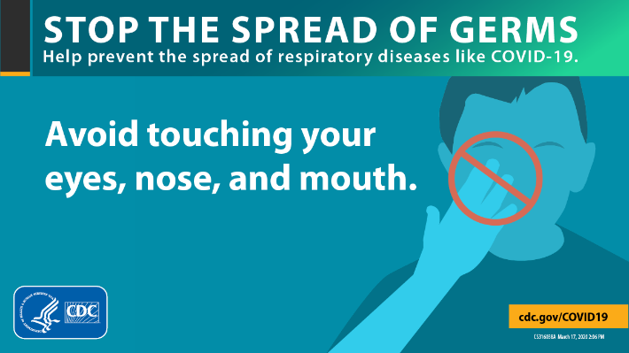
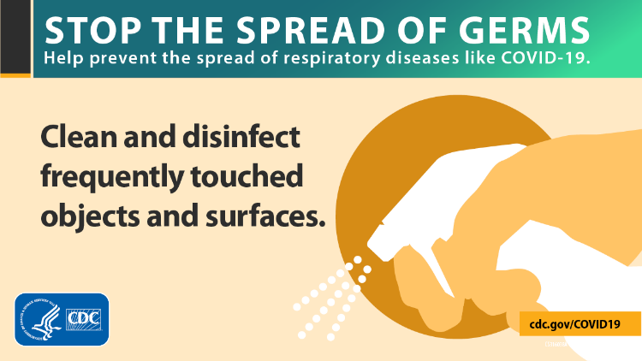
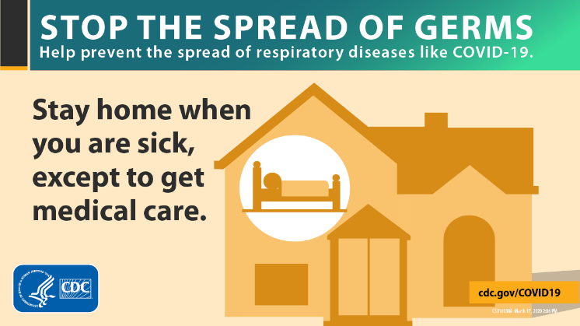
FOLLOW CDC GUIDELINES

Slide 29
Thank you for doing your part at keeping Buffalo Schools Strong
Jamie Warren, Associate Superintendent for Human Resources, BPS

